Slide 1



KA220-YOU - Cooperation partnerships in youth CAZE 2021-1-ES02-KA220-YOU-000028880
CAZE Stimulating creativity in digitalization era
MULTIPLIER EVENT
BUZAU ROMANIA
23 MARCH 2024

Slide 2







Applicant Organization:
ASSOCIATION DE COOPERATION AL DESAROLLO
ABARKA
Participant Organizations:
- Cercle Augustin d’Hippone
- Mine Vaganti NGO
- Namoi
- Integrare Europeana In Domeniul Tineretului, Sportului, Voluntariatului Si Cetateniei Active Europene
- Iteach International Training And Learning Institute
- SC Psihoforworld

Slide 3
Within the Europe 2020 Strategy, our project contributes to entrepreneurship education and training for young people from rural areas, young migrants, young people with reduced opportunities, in our project are called young CAZE.
The young people in our target group have finished their studies, some of them have small businesses but the share on the sales market is still difficult, they have more access through fairs, they sell products to other distributors, sometimes they stay with their products in stock. The CAZE project helps CAZE young people and youth workers to learn entrepreneurship with all modern and digital tools.
The young CASES will be trained by experienced youth workers who are entrepreneurs themselves nowadays and share their current knowledge and experience with them. The intellectual result will be that both CAZE young people and youth workers will develop their basic skills and confidence to create and develop their own business and will know how to use digital tools for this.
The target groups of our project are young people aged between 18 and 35 from rural areas, immigrants, young people with reduced opportunities, youth workers, youth organizations.
In our project, we stimulate and practice the use of digital skills in 21st century e-commerce, including literacy skills such as 3D printing, virtual reality, website and store design, and media literacy through e-learning and publishing, learning such as conceptual and creative thinking by collaborating in a team and with other independent professionals and communicating through modern channels.

Slide 4

OBJECTIVES
1. Developing the capacity for self-entrepreneurship for youth from target group a sustainable and independent life;
2. Promoting the social inclusion of youth target group “CAZE” in EU countries by empowering them to enter the labor market through newly acquired skills.
3. Development of digital skills in the field of new technologies, promoting interaction between participants and specialists-mentors in the digital field;
4. Enhancing the capacity of organisations to work at international level by implementing a European project

Slide 5
Implementation: What activities we implement
PPR1: An educational format tested and validated to teach basic, transversal and entrepreneurial skills applied especially in the field of craft;
PPR2: An e-commerce platform “CAZE”
PPR3: A comprehensive set of digital tools to support the e-commerce platform;
* Learning / teaching / training activities (LTT1)
Multiplication events:
8 multiplier events will be organized (1 in each country) which will contribute to the dissemination of the project results

Slide 6
PPR1 - Ethnicraft training format for up-skilling youth CAZE
Description: partners will organize an international seminar in Turkey to develop a new training format for the up-skilling of youth CAZE with handicraft skills in basic and transversal skills the lack of which constitute a barrier to entry to the EU labor market. The partners will organize a meeting with stakeholders working with youth at the local level by the hosting organization, carrying out a needs analysis. The training format will be based on the identified needs of youth and it will contain a methodology of teaching that will take into account intercultural differences starting from the current skills of learners. Furthermore, a strong innovative character will be put on the creation of a new methodology of teaching transversal skills with a strong focus on intercultural issues. Stakeholders working in cultural mediation will also be actively engaged during the seminar.
The methodology applied for the creation of the output:
1. Elaboration of a draft training format by participants to the seminar;
2. Sending the draft to all partner organizations and receiving feedback from them;
3. Collection of the feedback from partner organizations and refinement of the training format.
Turkey will create a final version of it basing on the draft produced by participants, with the collaboration of all partners.

Slide 7
PPR2 - E-commerce platform
Description: The project partners will create an e-commerce platform directed to youth handicraft products. This platform will also be used during the mobilities so that youth will get used to it and effectively use it after the project completion. The platform will be multilingual and easily meaningful both for customers and for youth. The platform will be inspired by the principles of easiness-of-use and efficiency.
Methodology:
1. Creation of the web architecture by the partners;
2. Feedback from project partners on the final structure of the e-commerce platform; 3. Creation of the demo platform to be
put online with the upload of a limited set of sample products from youth CAZE;
4. Asking for feedback from youth crafts by the mean of NGOs working with them and during the blended mobilities;
5. Definition of the final version of the platform, uploading the handicraft products and market launch

Slide 8
PPR3 - E-commerce toolkit for youth CZAE.
Description: The platform comes with a toolkit containing instruments and guidelines to guide youth CAZE in their eommerce self-entrepreneurial path. It will contain:
- Marketing and communication strategies useful to manage a simple e-commerce business;
- Multilingual video tutorials with a technical explanation of the use of the newly created platform.

Slide 9
Learning Training teaching activity in Sassari, Italy
The goal of the mobility training: to train youth CAZE crafts persons on basic, transversal and soft skills in order to improve theirmastery of communication and behavioural techniques.
Venue: Sassary Italy
Hosting organisation:
Duration: 5 training days plus 4 travel day (green travel)
Participants: 56 participants in total aged 18-35, including 14 youth workers. Every partner involved in mobility will send 8 youth CAZE and 2 youth worker.
The blended mobility training will test the Ethnicraft training format created in PPR1.
Participants and trainers will be asked to provide feedback on the training format, that will be collected and integrated into a revised version of the training format methodology.

Slide 10
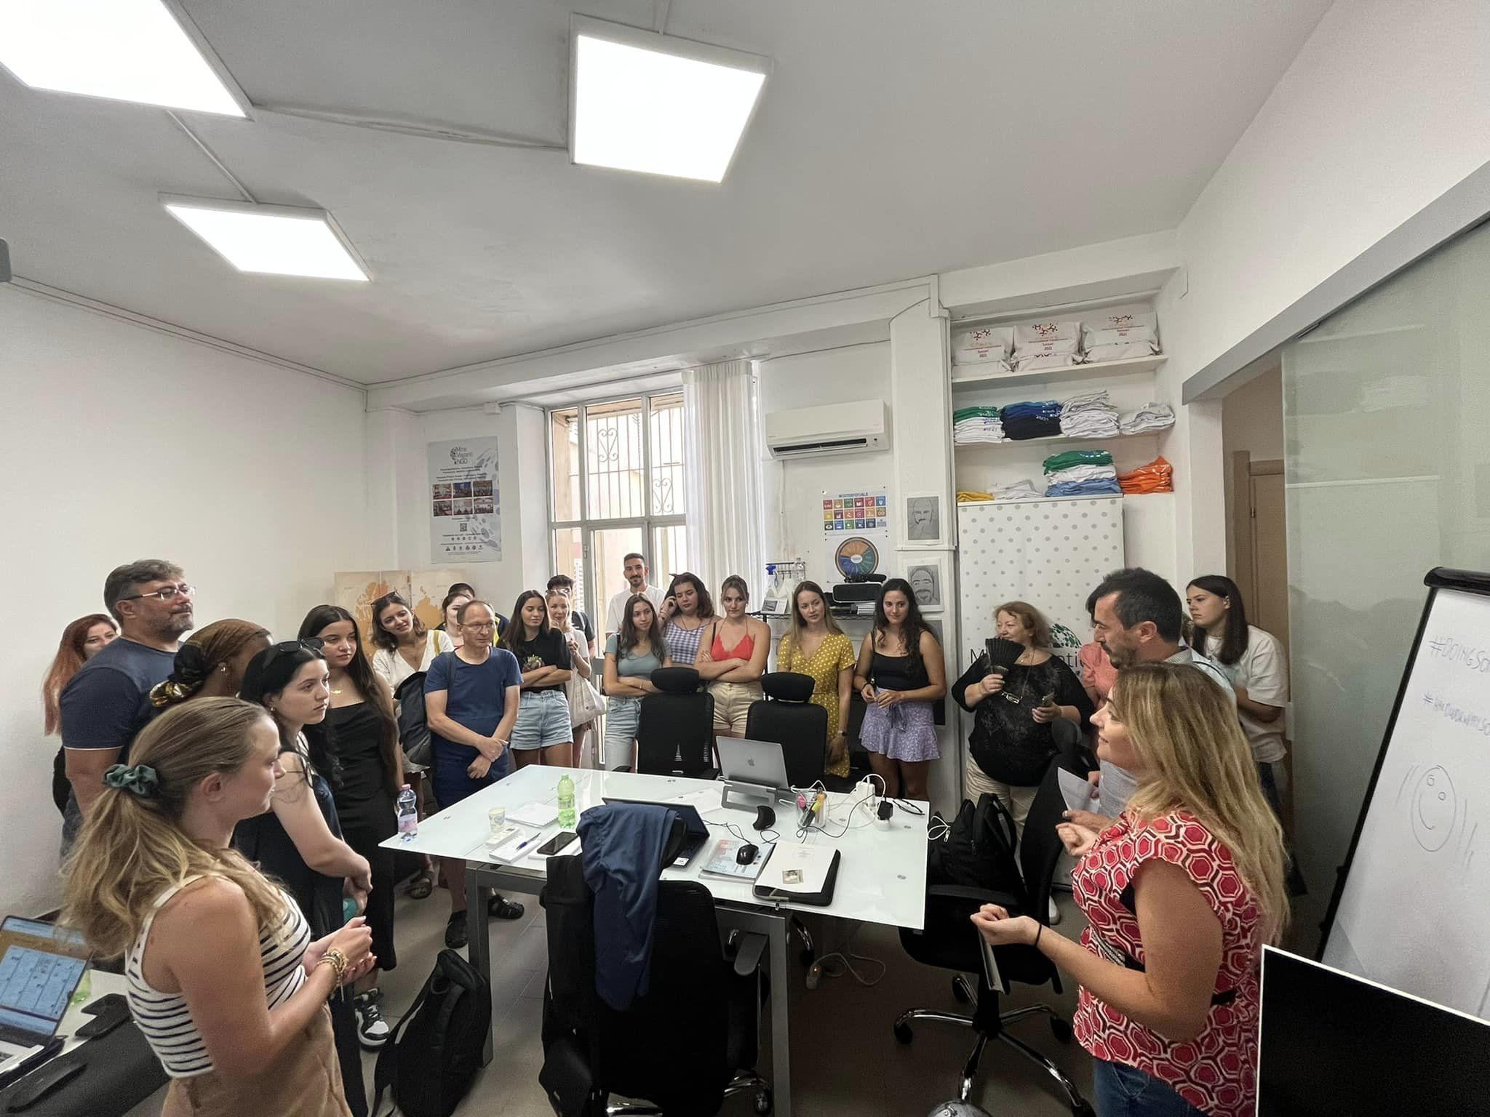
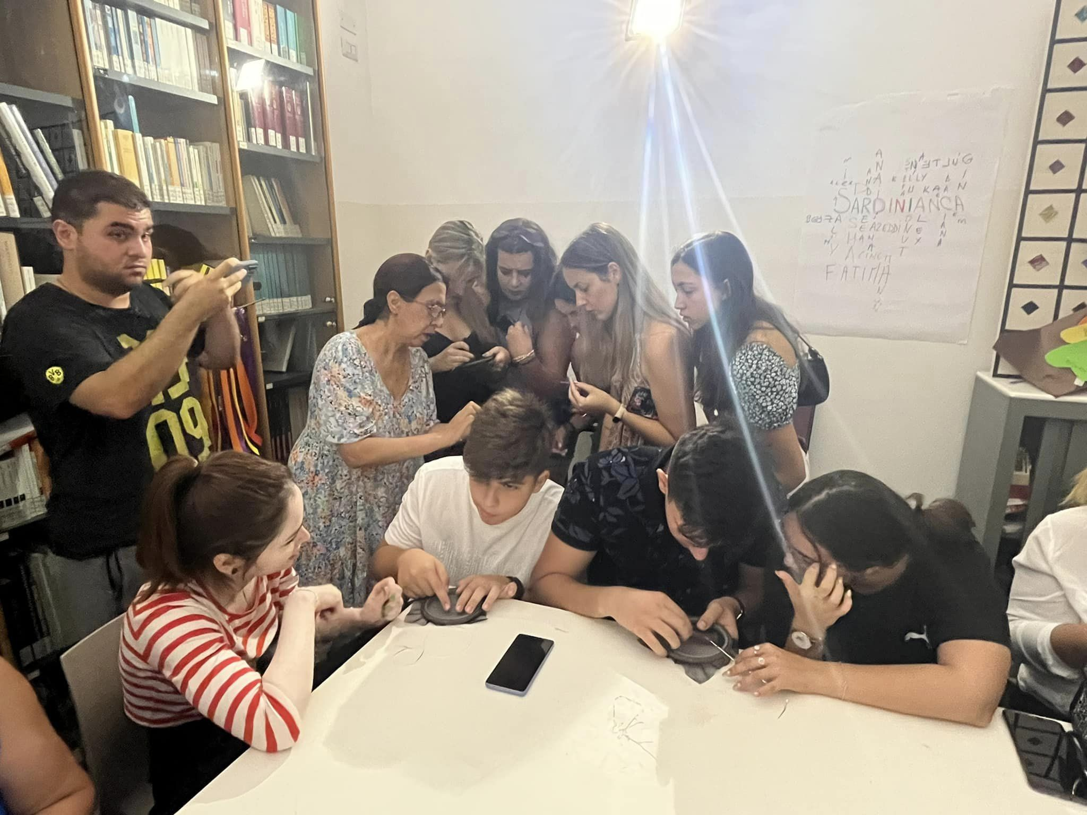
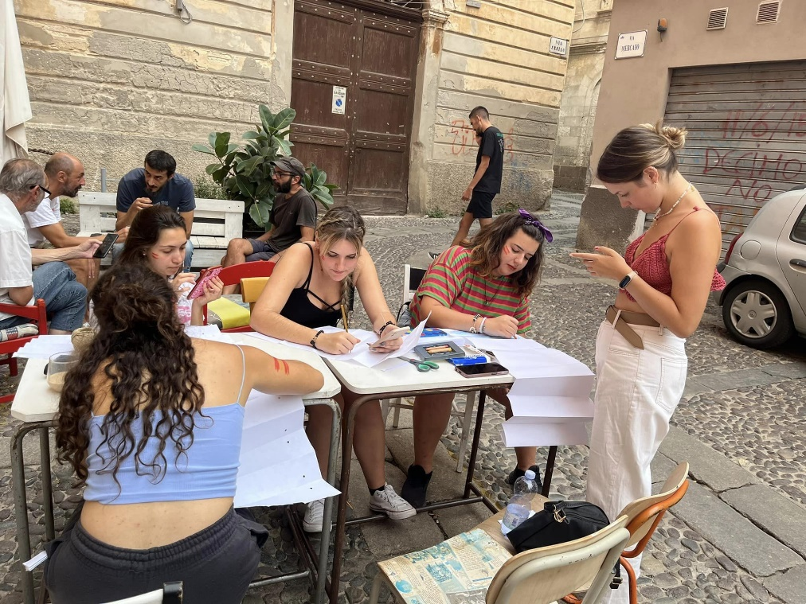

Slide 11
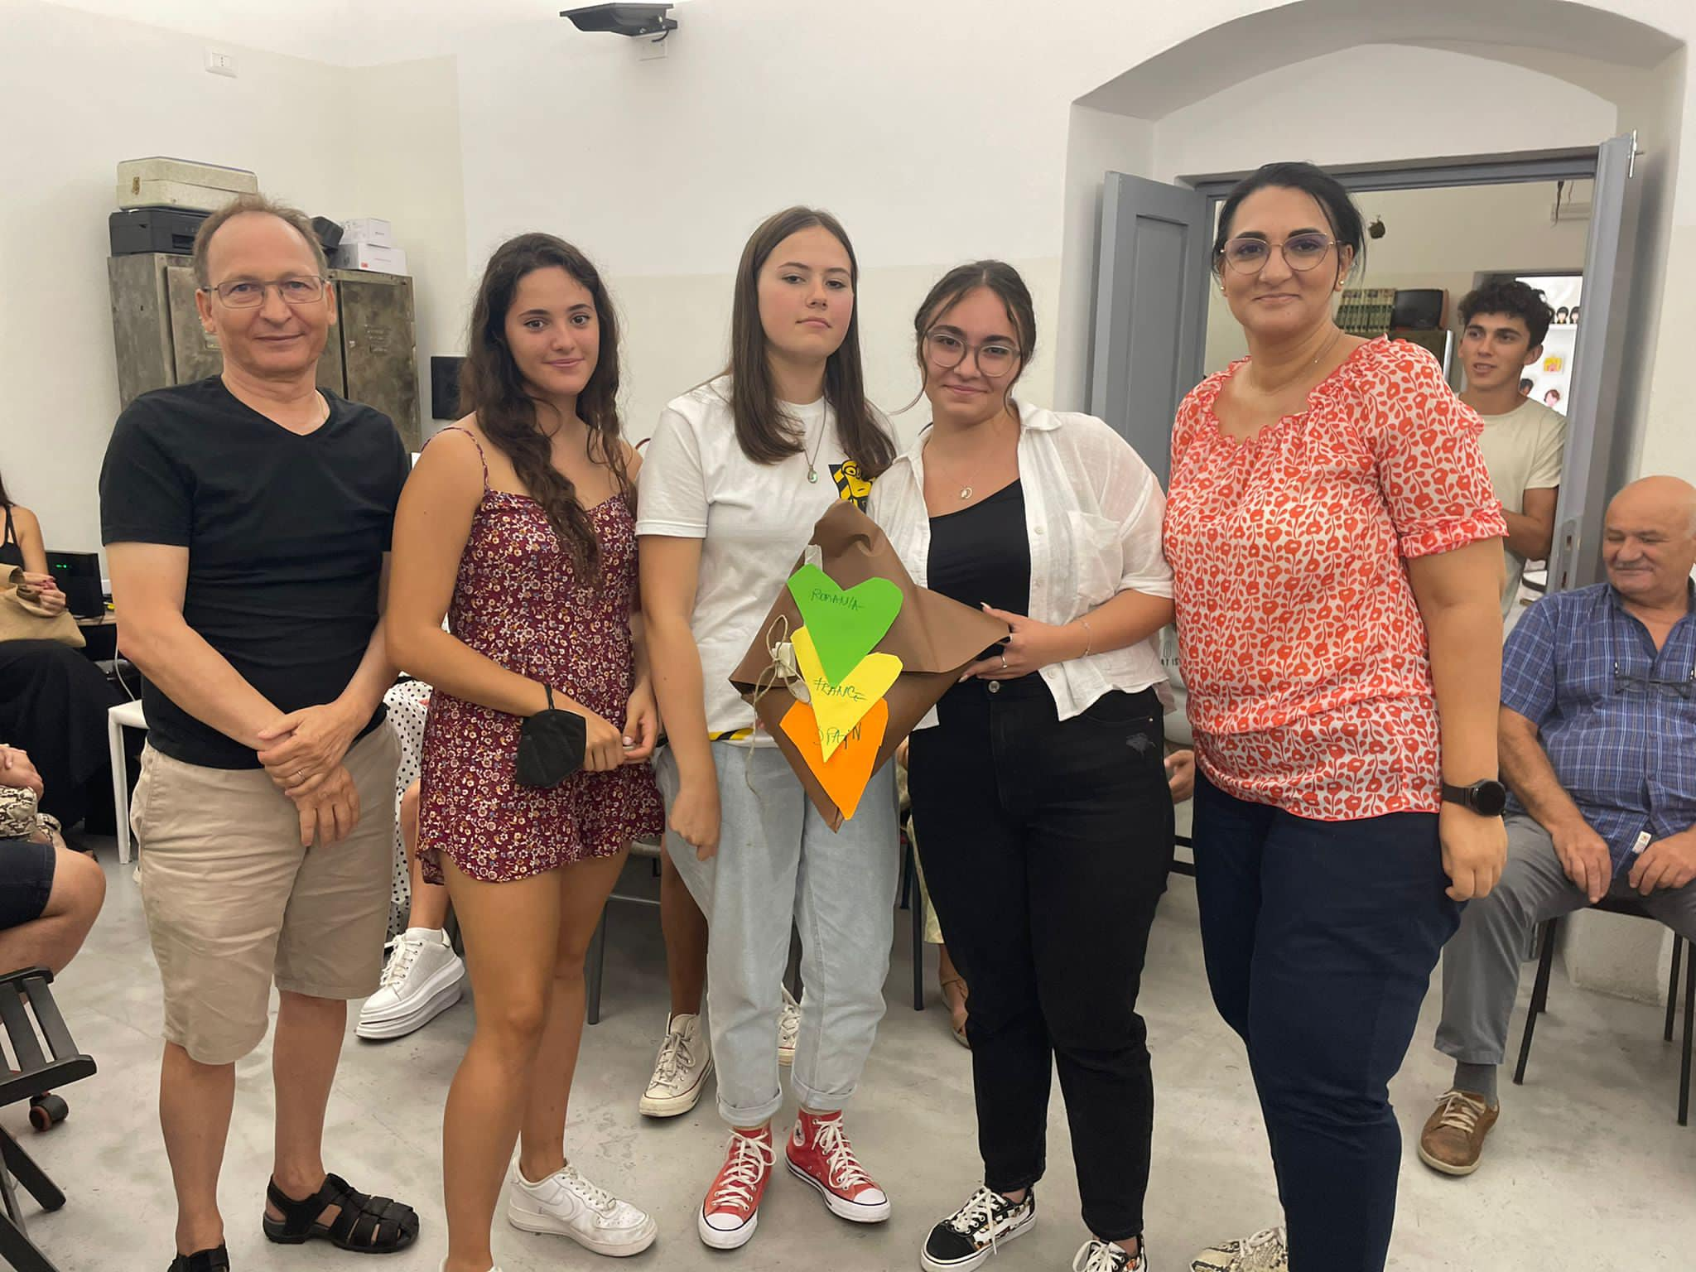
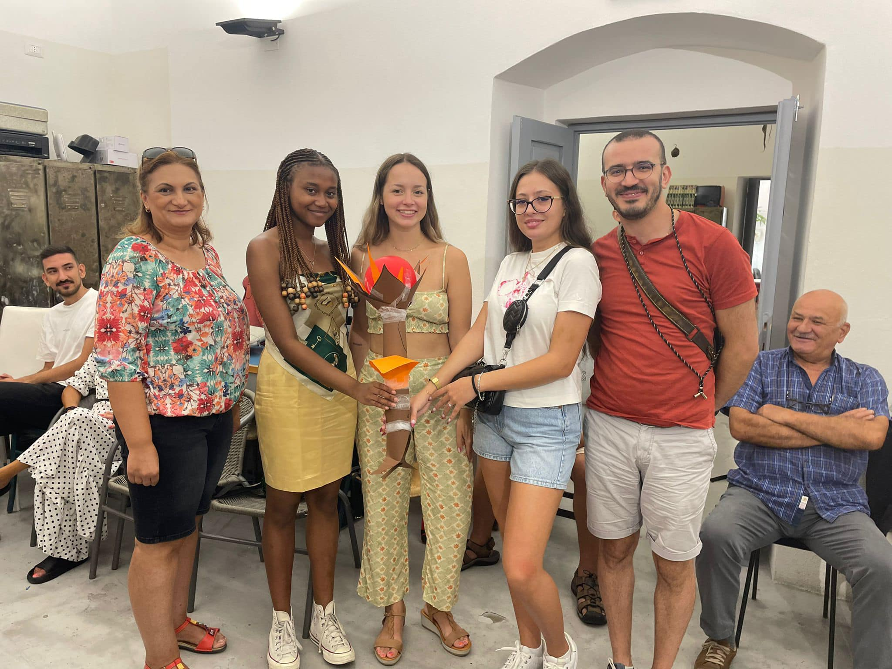
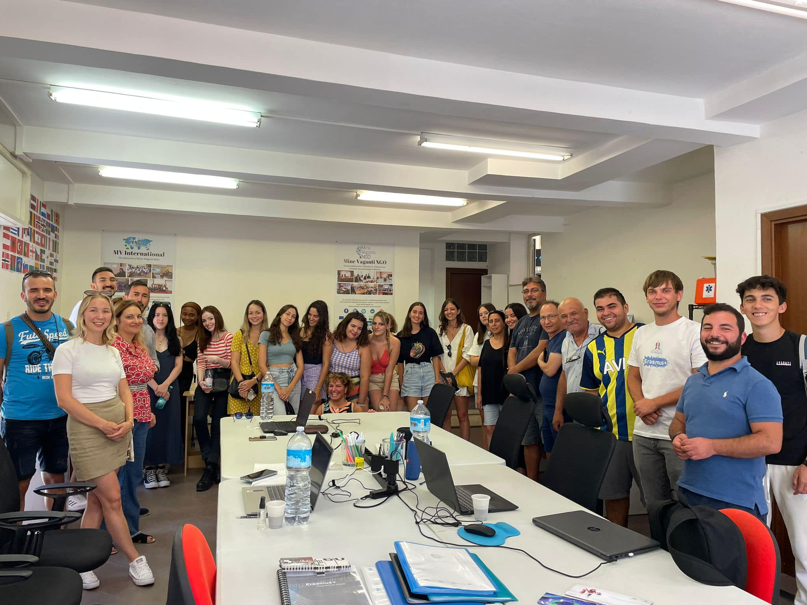
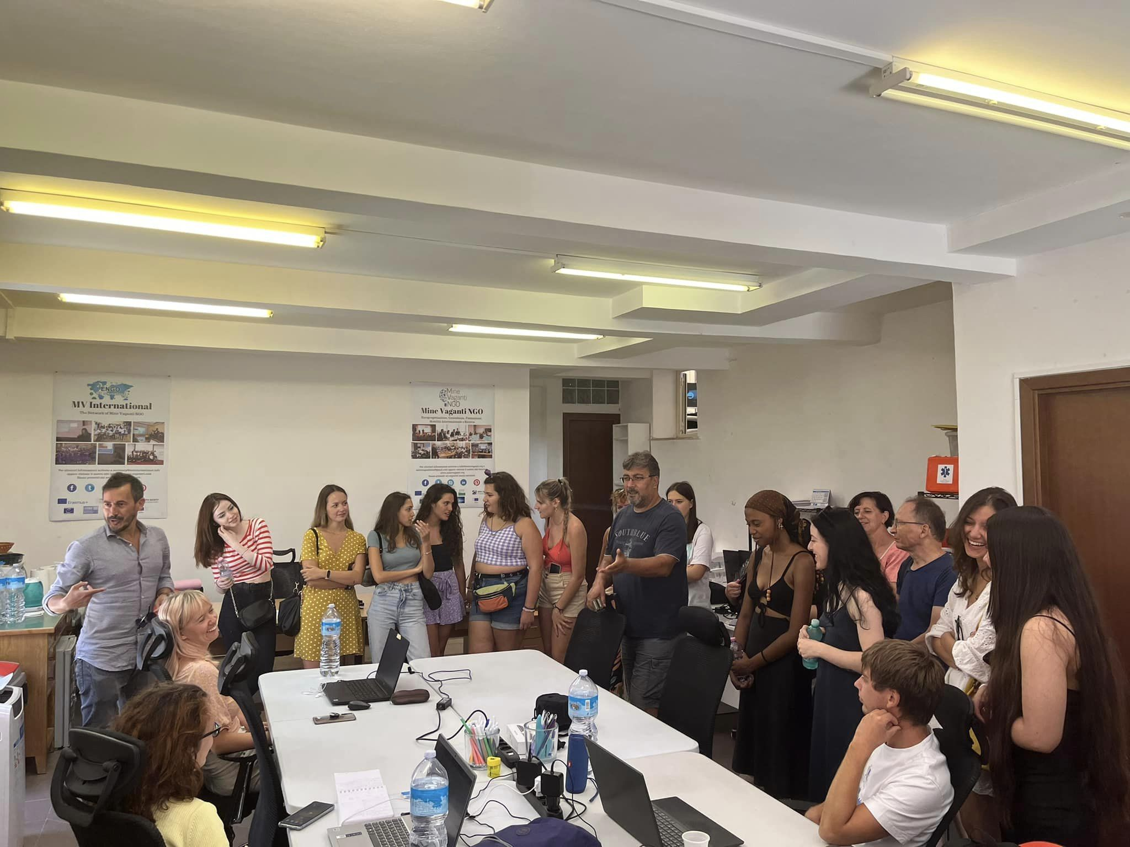

Slide 12
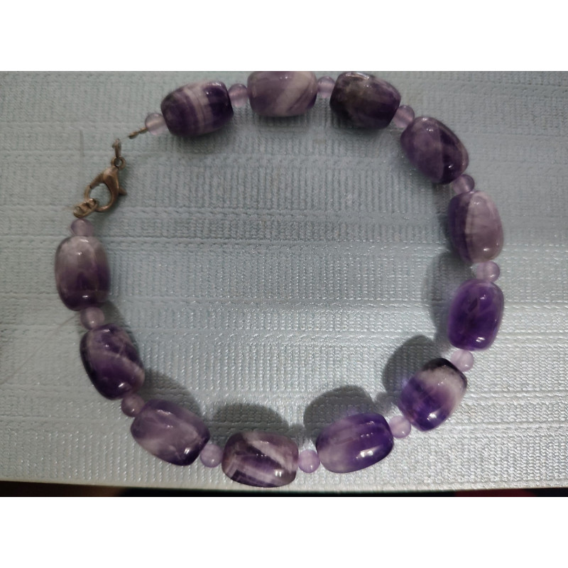
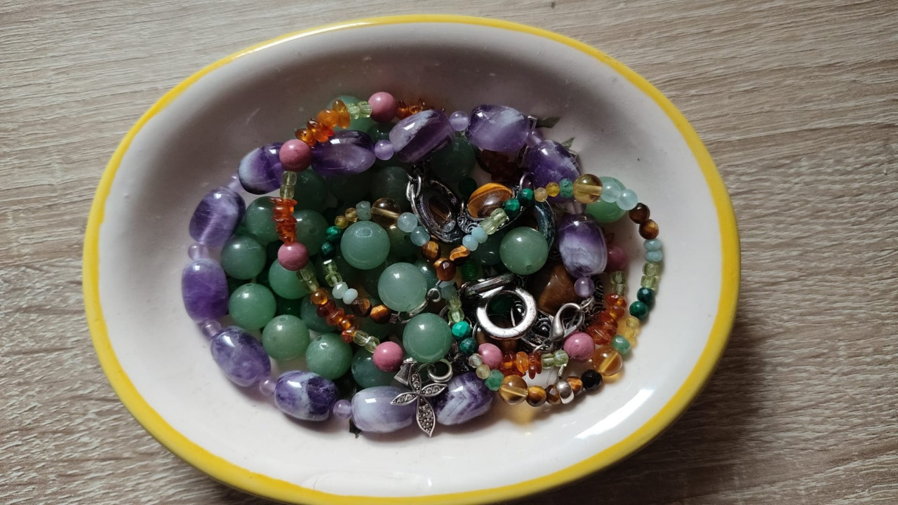
Shops we created as part of IO3 output
Handmade jewelry
Welcome to Handmade Jewelry, a digital sanctuary where every piece tells a story of craft and passion. Our online store is a tribute to artists who put soul into every knot, string and cut, creating accessories that not only adorn, but also delight the spirit. Here, you will discover a neat collection of handcrafted bracelets
https://caze.eurosyvec.eu/index.php?render_type=sellerview&id_seller=8&fc=module&module=kbmarketplace&controller=sellerfront&id_lang=1

Slide 13
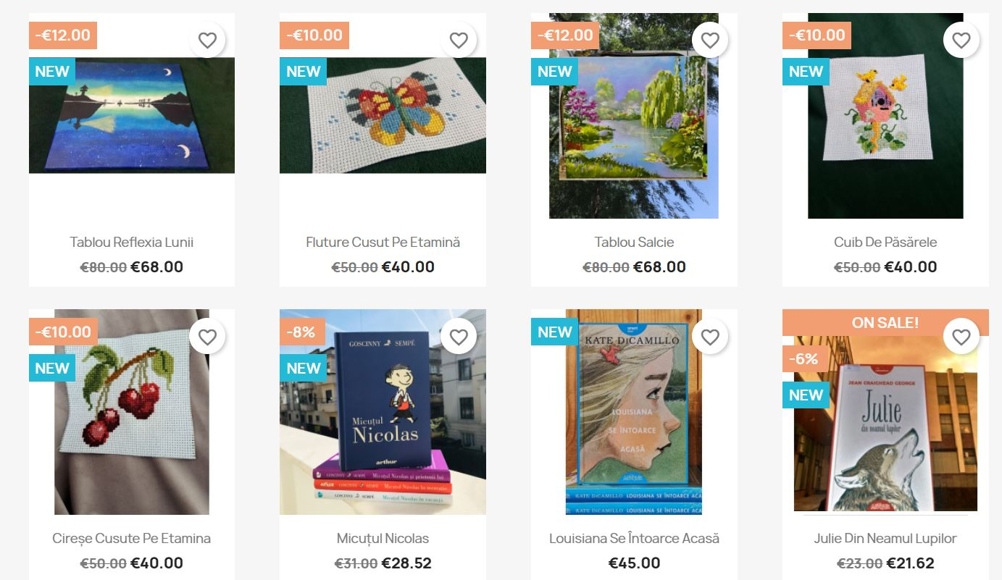

Slide 14
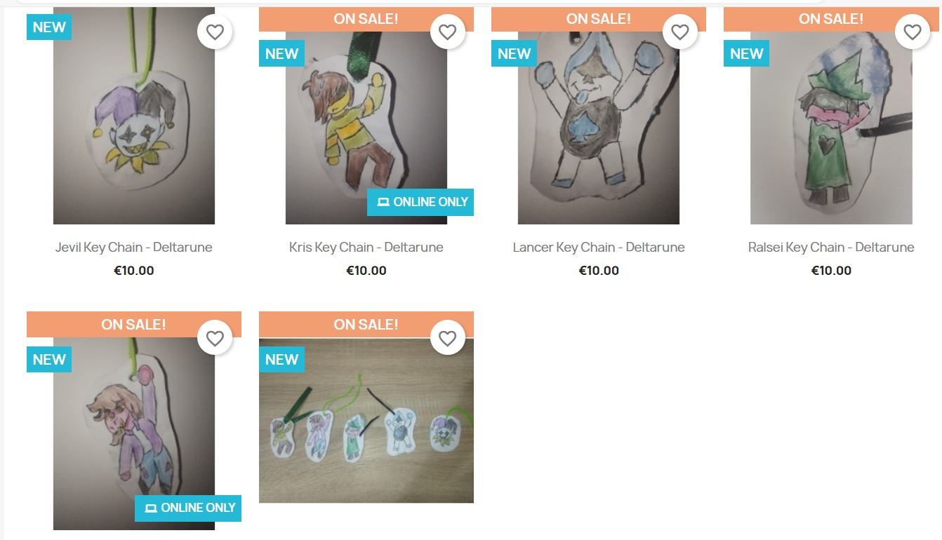
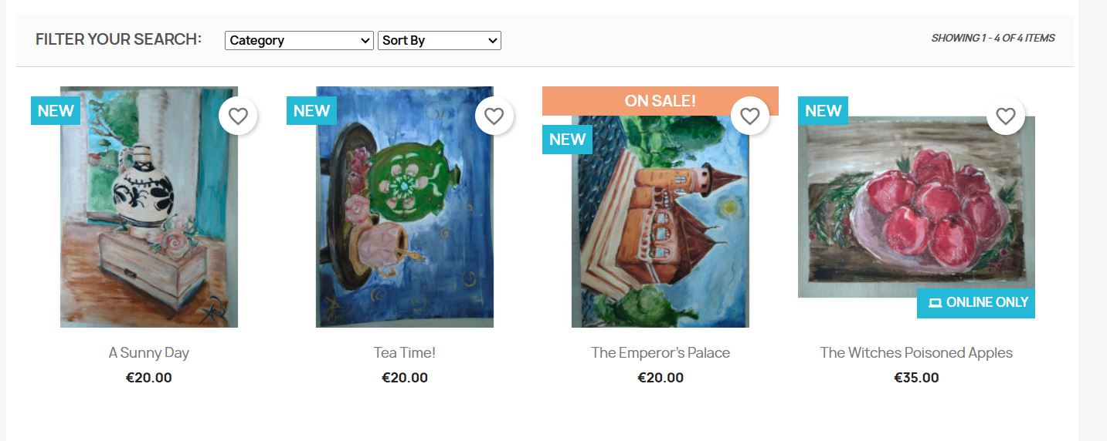
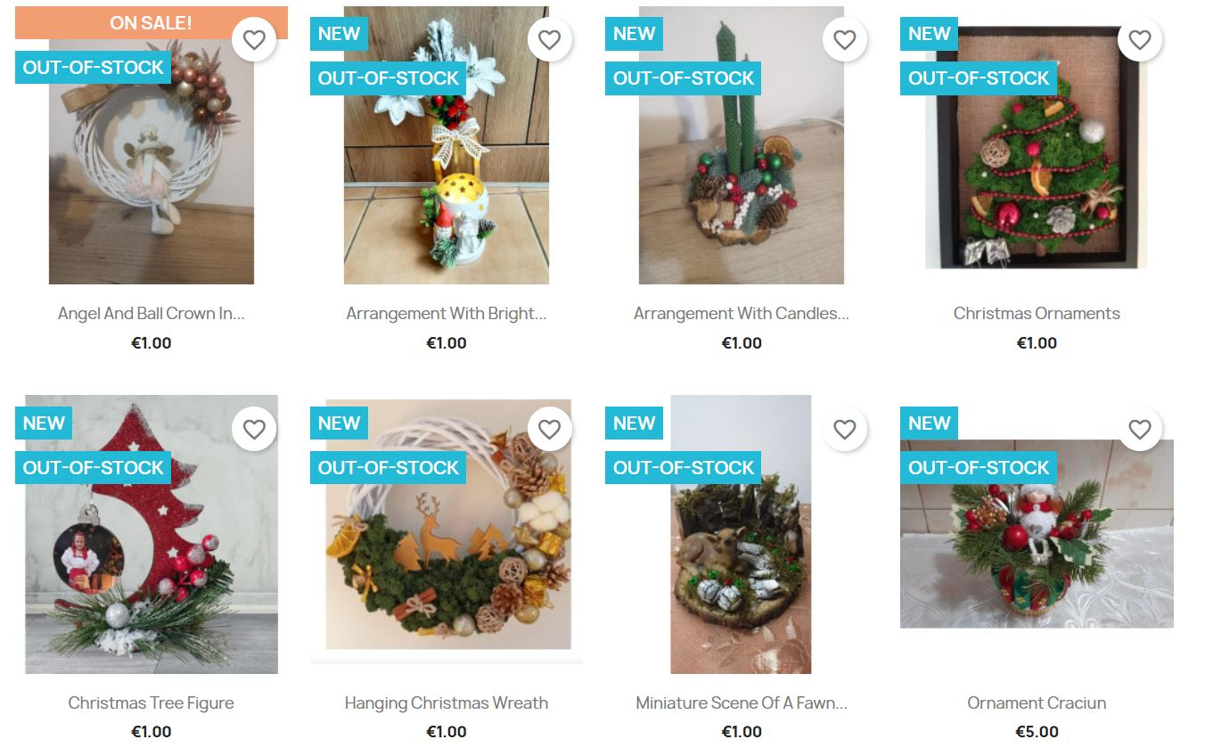
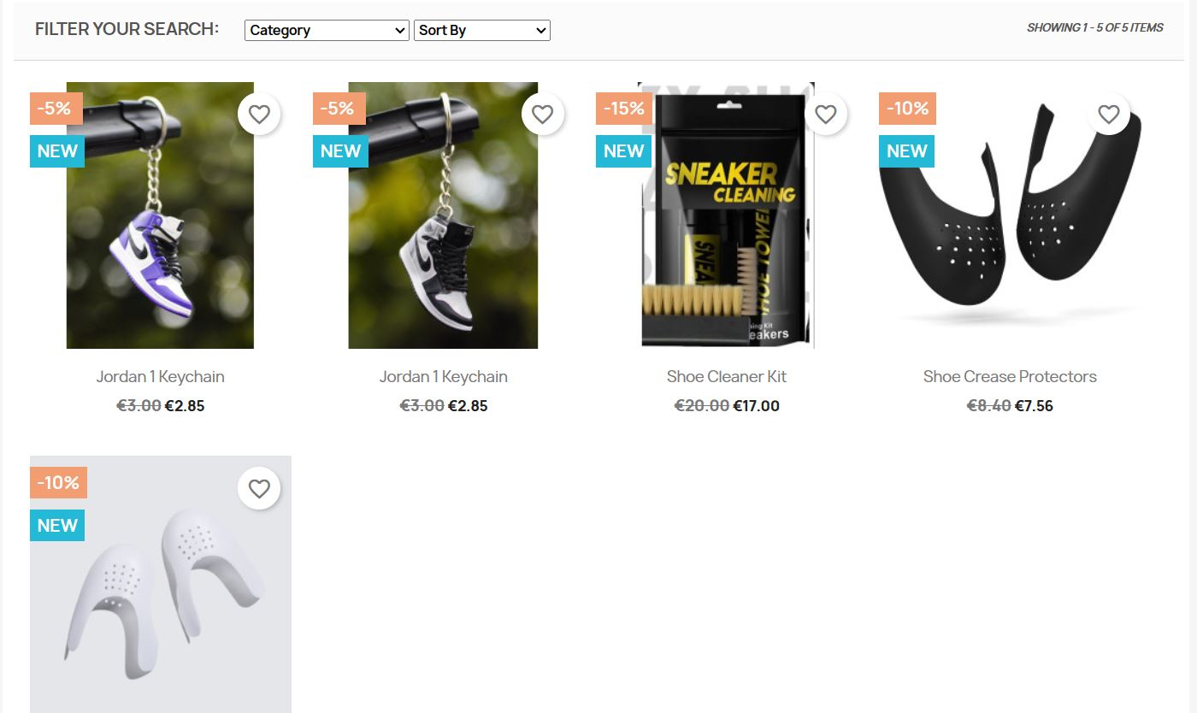

Slide 15
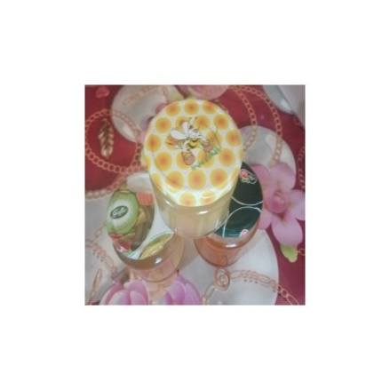

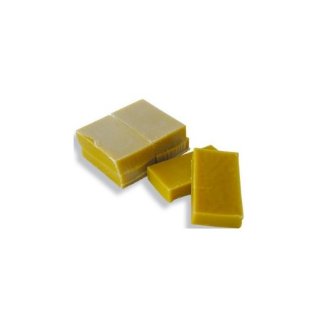
Carpathian bee- Zum! Zum! Zum!
https://caze.eurosyvec.eu/index.php?render_type=sellerview&id_seller=13&fc=module&module=kbmarketplace&controller=sellerfront&id_lang=1
Welcome to "Carpathian Bee", a family business with tradition, where passion and respect for nature intertwine harmoniously to produce the purest and healthiest bee products. In the heart of the Carpathian mountains, our beehives are cared for with skill and dedication, ensuring that our bees benefit from an ideal habitat to harvest the purest nectar. At "Carpathian Bee", we believe in sustainability and promoting a healthy lifestyle.

Slide 16
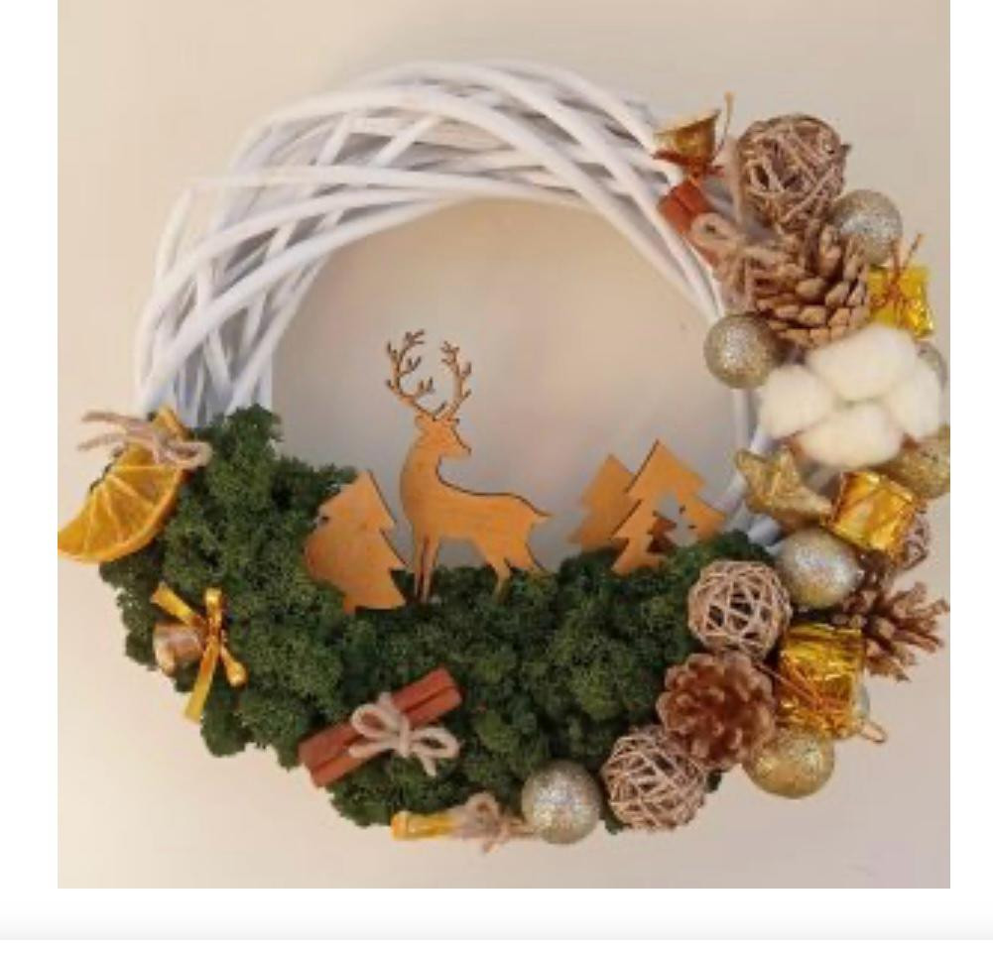
ArtDeco
The interior decoration workshop "ArtDeco" is focused on the use of natural and eco-friendly materials, creates a harmonious and authentic environment for holidays and special events such as Christmas, Easter, family anniversaries, weddings and baptisms.
https://caze.eurosyvec.eu/index.php?render_type=sellerview&id_seller=9&fc=module&module=kbmarketplace&controller=sellerfront&id_lang=1

Slide 17
Hello, here are 10 tutorials on creating and managing a seller account.- IO3 - seller account tutorials
10. Profit and order verification https://youtu.be/5vGxhv9APTo9. Creation and application of discounts and coupons https://youtu.be/MvFGI9wzJZc8.
Shipping and delivery https://youtu.be/w_3Tpqj8W3g7.
How to add a product to the account https://youtu.be/_rqA6cRp0t86.
How to set up your seller account https://youtu.be/4XOq0BoXDT45.
How to activate the membership plan https://youtu.be/gBOCDIaOKqA4.
How to create a seller account https://youtu.be/ca_juSWenwU3. The main page and how you can access the product https://youtu.be/MX-11WyVI9o2. ⁠
How to use the customer account https://youtu.be/aWJ_VEfV2ws1. How to create an account on the platform https://youtu.be/TOftqxx7XCU
All these tutorials can be found both on YouTube and in Drive https://drive.google.com/drive/u/0/folders/1wQYMHAGb5iO3w2trosYrhq3mdtPn5I1O .
https://www.youtube.com/channel/UCA0OlZ-3NeGq2CDWnFWgZnw

Slide 18
Here are two podcast made by member and voluntier of our association
Marketing and communication strategies to manage e-commerce business. IO3-INTEGRARE EUROPEANA
https://youtu.be/CmxuqFsRYx8?si=vZDPthZvVY3LHBkI
First steps in the e-commerce _PRIMII PASI IN COMERTUL ELECTRONIC-IO3-PODCAST1-INTEGRARE EUROPEANA
https://youtu.be/briZrqAJOMQ?si=AMhFiiqeRN95aDe5

