Slide 1


Time Management and Productivity Tips for Online Entrepreneurs
Maximizing Your Efficiency and Success
Learn how to manage your time more effectively and achieve your goals.

Slide 2

Introduction
Welcome to this presentation on time management and productivity for online entrepreneurs.
I’m Sanda-Daniela, and I'm a certified time management coach.
I've helped hundreds of entrepreneurs learn how to manage their time more effectively, and I'm excited to share my tips with you today.
Photo by Pexels

Slide 3

The Importance of Time Management
As an online entrepreneur, you're probably wearing a lot of hats.
You're responsible for marketing, sales, customer service, accounting, and more.
That's where time management comes in.
Time management is the process of planning and organizing your time in a way that allows you to be more productive.
When you manage your time effectively, you can:
Get more done
Reduce stress
Improve your work-life balance
Achieve your goals
Photo by Pexels

Slide 4

The 2-Minute Rule
One of the simplest and most effective time management tools is the 2-Minute Rule.
The 2-Minute Rule says that if a task can be completed in 2 minutes or less, you should do it right away.
This rule helps you to avoid procrastination and to stay on top of small tasks that can quickly become overwhelming.
Photo by Pexels

Slide 5
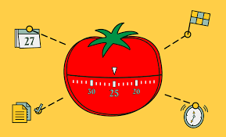
The Pomodoro Technique
The Pomodoro Technique is a time management method that breaks down work into intervals, traditionally 25 minutes in length, separated by short breaks.
The Pomodoro Technique works like this:
Set a timer for 25 minutes.
Work on a single task until the timer goes off.
Take a 5-minute break.
After four pomodoros, take a longer break of 15-20 minutes.
Repeat.
Photo by Pexels

Slide 6
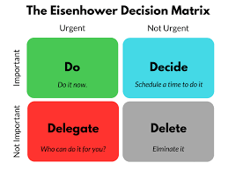
Prioritization
One of the most important aspects of time management is prioritization.
You need to be able to identify the most important tasks and focus your time on those.
There are a number of different ways to prioritize tasks, but one simple method is to use the Eisenhower Matrix.
The Eisenhower Matrix divides tasks into four quadrants:
Important and urgent
Important but not urgent
Not important but urgent
Not important and not urgent
The tasks that fall into the "Important and urgent" quadrant are the ones that you should focus on first.

Slide 7

Delegation
As an online entrepreneur, you don't have to do everything yourself.
You can delegate tasks to others.
This can free up your time so that you can focus on the most important tasks.
When you delegate tasks, it's important to be clear about what you need done and to set clear deadlines.
Photo by Pexels

Slide 8

Taking Breaks
It's important to take breaks throughout the day.
This will help you to stay focused and productive.
When you take breaks, get up and move around.
Step outside for some fresh air.
Or, take a few minutes to meditate or do some deep breathing exercises.
Photo by Pexels

Slide 9

Avoiding Distractions
Distractions can be a major time suck.
To avoid distractions, it's important to create a distraction-free environment.
This means turning off your phone, closing unnecessary tabs on your computer, and finding a quiet place to work.
Photo by Pexels

Slide 10

Staying Motivated
It's important to stay motivated when you're working on a project.
There are a number of things that you can do to stay motivated, such as:
Setting goals
Rewarding yourself for completing tasks
Celebrating your successes
Finding a mentor or accountability partner
Photo by Pexels

