Slide 1


Creating an Online Store on Ethnicraft
A Step-by-Step Guide for Entrepreneurs

Slide 2
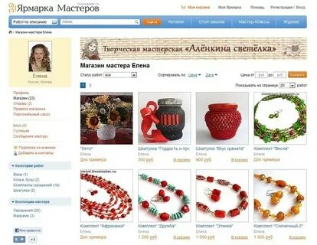
Slide 1: Introduction
Welcome to this presentation on how to create an online store on Ethnicraft.
I’m Sanda-Daniela, and I'm a certified online entrepreneur.
I've helped hundreds of entrepreneurs create successful online businesses, and I'm excited to share my knowledge with you today.
Photo by Pexels

Slide 3
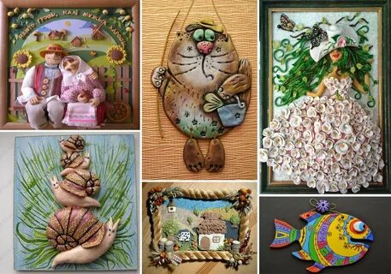
Slide 2: What is Ethnicraft?
Ethnicraft is a platform that makes it easy for anyone to create an online store.
It's a user-friendly platform that doesn't require any coding or design experience.
With Ethnicraft, you can create a professional-looking online store in minutes.
Photo by Pexels

Slide 4

Slide 3: Benefits of Creating an Online Store on Ethnicraft
Ease of use: Ethnicraft is very user-friendly platform that doesn't require any coding or design experience.
Affordability: Ethnicraft is very affordable, especially when compared to other platforms.
Flexibility: Ethnicraft is very flexible, allowing you to customize your store to fit your needs.
Reach: Ethnicraft has a global reach, giving you the opportunity to sell to customers all over the world.
Photo by Pexels

Slide 5

Slide 4: Creating an Account
The first step to creating an online store on Ethnicraft is to create an account.
To do this, simply visit the Ethnicraft website and click on the 'Create an Account' button.
You will be prompted to enter your email address, password, and business name.
Photo by Pexels

Slide 6

Slide 5: Configuring Your Profile
Once you have created an account, you will need to configure your profile.
This includes adding your contact information, shipping and payment information, and tax information.
You will also need to choose a template for your store.
Photo by Pexels

Slide 7

Slide 6: Adding Products
The next step is to add products to your store.
To do this, simply click on the 'Products' tab and click on the 'Add Product' button.
You will be prompted to enter the product name, description, price, and inventory quantity.
Photo by Pexels

Slide 8

Slide 7: Setting Up Shipping and Payments
You will also need to set up shipping and payments for your store.
Ethnicraft offers a variety of shipping and payment options, so you can choose the ones that work best for your business.
Photo by Pexels

Slide 9

Slide 8: Promoting Your Store
Once your store is set up, you will need to promote it.
There are many ways to promote your store, including:
Search engine optimization (SEO): SEO is the process of optimizing your website so that it appears higher in search engine results pages (SERPs).
Social media marketing: Social media is a great way to reach a large audience and promote your store.
Email marketing: Email marketing is a great way to stay in touch with your customers and promote your store.
Photo by Pexels

Slide 10
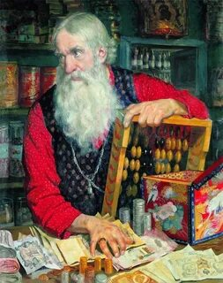
Slide 9: Managing Your Store
Once your store is up and running, you will need to manage it.
This includes tasks such as:
Adding new products: As your business grows, you will need to add new products to your store.
Updating product information: You will also need to update product information, such as prices and inventory quantities.
Processing orders: When customers place orders, you will need to process them.
Shipping orders: Once orders are processed, you will need to ship them to customers.
Handling customer inquiries: Customers may have questions about your products or your store. You will need to handle these inquiries in a timely and professional manner.
Photo by Pexels

