Slide 1


"Integrare Europeană în Domeniul Tineretului, Sportului, Voluntariatului și Cetățeniei Europene Active" E10163149
2013-2024
2024
ZONA INTEGRARE EUROPEANA
E10163149

Slide 2
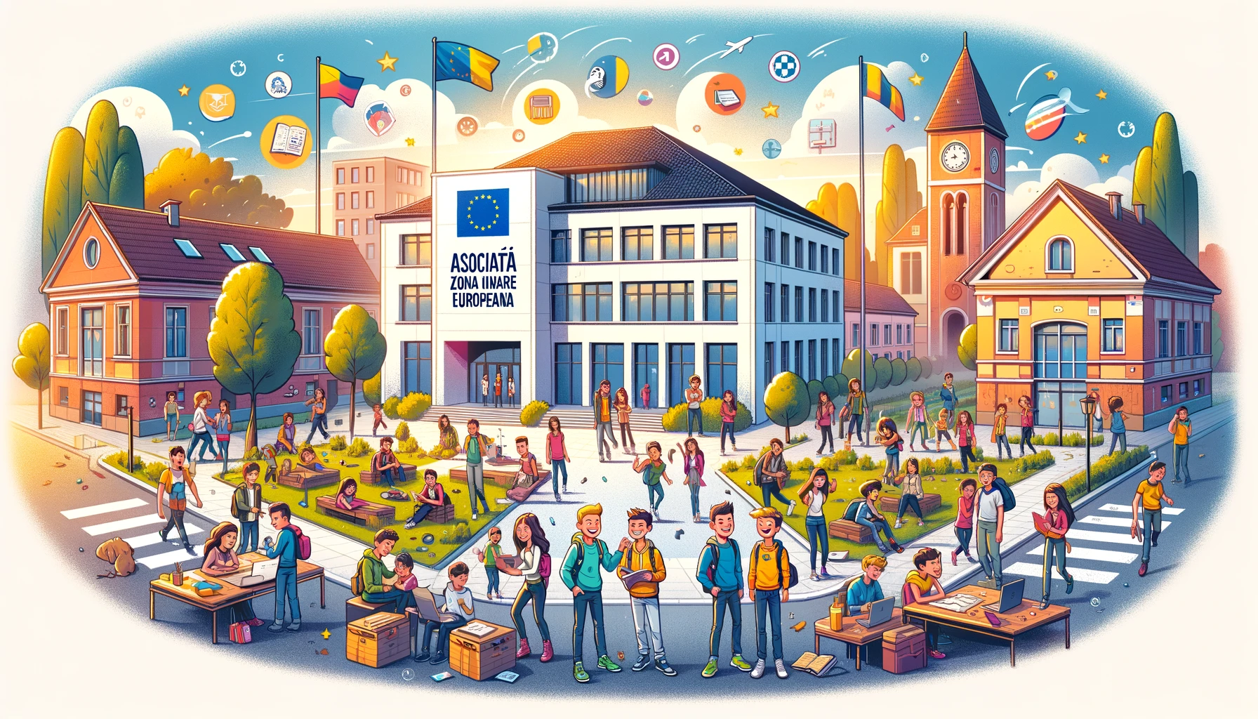

ABOUT US
The Asociația “ZONA INTEGRARE EUROPEANA" is a non-profit legal entity based in Buzău, Romania.
Its main purpose is to promote the EU 2014-2027 strategy in areas such as youth, educational innovation, volunteering, sports, and active European citizenship.
The Association focuses on developing national and international projects and partnerships, supporting non-formal education, reducing functional illiteracy, and providing opportunities for youth. It operates based on a board of directors and general meetings, with a specific financial heritage and regulations.

Slide 3
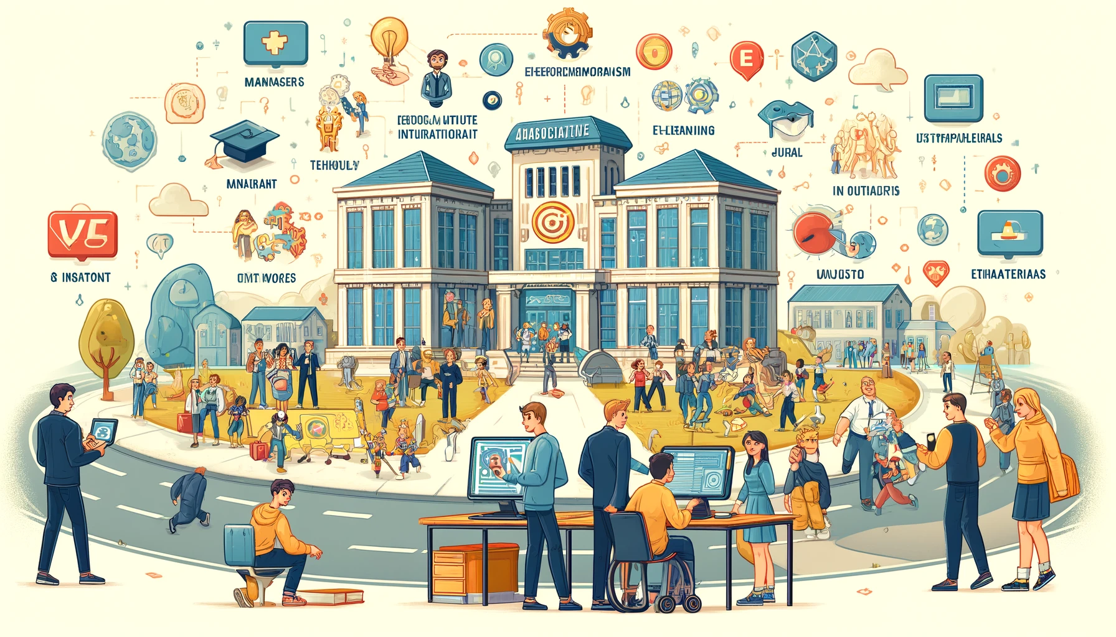
The Asociația “ZONA INTEGRARE EUROPEANA" stands out for implementing innovative projects in education and social integration.
This includes the development of e-learning platforms, training programs for individuals with autism spectrum disorders, and projects to enhance digital and entrepreneurial skills for youth.
With a strong emphasis on using technology in education and training, the organization actively contributes to the social and professional integration of vulnerable groups.
The organization's team, consisting of managers, teachers, youth workers, and IT specialists, collaborates to provide educational solutions tailored to the community's specific needs, showcasing expertise in various areas such as art therapy and digital education.
Their activities include developing educational content, professional training, and assistance in job market integration.
This commitment reflects the association's ability to effectively respond to the educational and integration needs of various target groups.

Slide 4
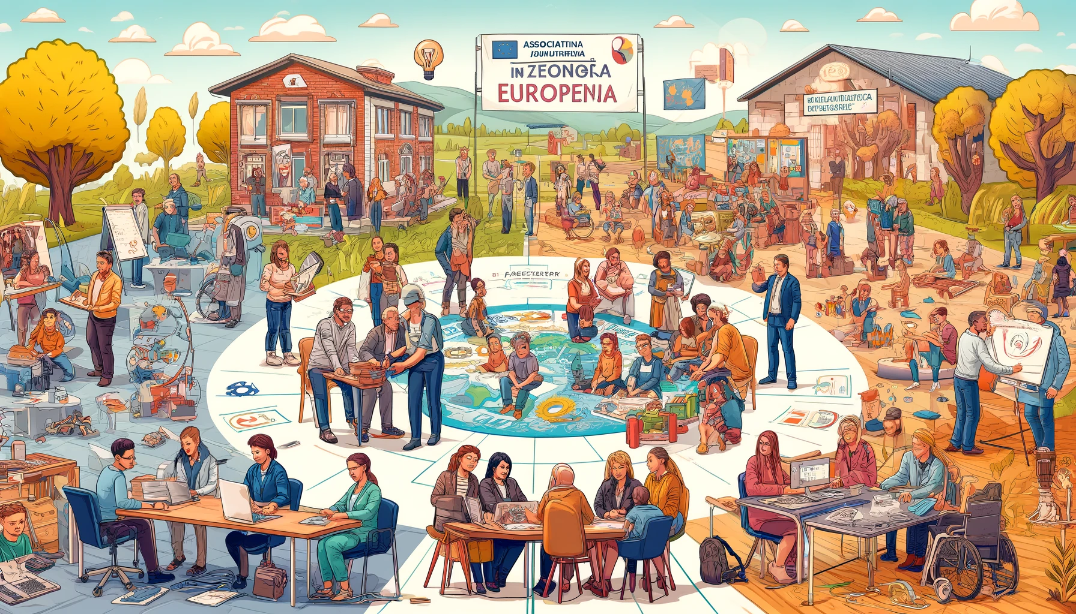
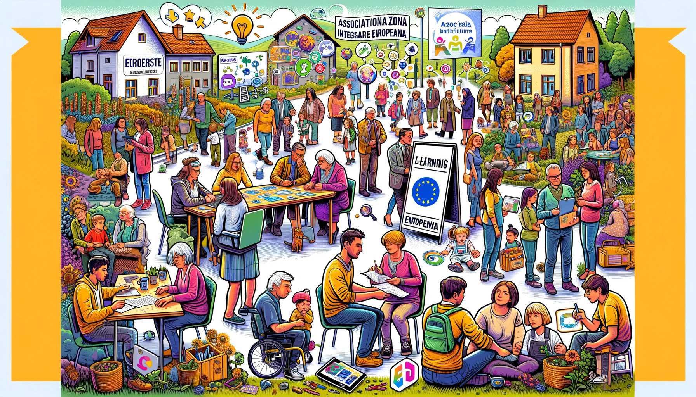
The Asociația “ZONA INTEGRARE EUROPEANA" focuses on various target groups:
Adults with autism spectrum disorders: Projects focus on improving their social and professional integration, offering tailored educational programs, professional training, and online counseling services.
Specialists in various fields: Include psychologists, social workers, teachers, and IT specialists involved in developing educational content and e-learning platforms.
Youth from rural areas and young immigrants: Benefit from support in developing entrepreneurial and digital skills, enhancing social integration and inclusion.
Teachers and students in preschool and primary education: Participate in projects aimed at improving digital skills and adapting to online education.
Trainers and youth workers: Involved in art therapy and ICT projects, developing digital and creative expression skills.
Adults, including those with disabilities: Focus on improving skills in preventing the effects of climate change and promoting circular economy principles.
Youth in youth mobility: Benefit from training and personal development opportunities in various Erasmus projects.

Slide 5

Activities and experience of the organization
2014-2020
Our organization has 37 trainers and youth workers with competencies developed in more than 12 training courses organized by associations and non-governmental organizations from France, Italy, England, Germany and Romania. These trainers and youth workers are able to prepare participants for mobilities, able to implement non-formal education-based activities and they are also able to participate in project management activities.
More than 150 young people participated in international mobility, with the help of the projects implemented by our organization, from 2014 to 2020.

Slide 6
Activities and experience of the organization
2019-2028 KA1
2019-2020
1.Erasmus + KA104 project "Social inclusion through dual education" which runs from June 1, 2019 - September 30, 2020.
Coordinator:ZONA Integrare Europeana Romania.
The purpose of the project is to promote the offer of learning and qualification opportunities in the workplace through dual education for people from the target group so that they integrate into the field of work.The target group of this project is made up of People in difficulty (13-26 years old) that have finished the eighth grade and have a maximum age of 26 years when they request to participate in this form of qualification at the DUAL EDUCATION job, and,also, parents of students at social risk.
Through this course, 12 adult education training participants specialized in the following fields:
Social media
Gamificatin
Dual education
2021-2022
Art-Therapy and ICT Zone - 2021-1-RO01-KA122-ADU-000018276:
This project targets trainers and youth workers, adults with disabilities or autism, and lifelong learning participants. Tangible outcomes include an e-learning platform "ICT ZONE" and the development of digital and creative artistic expression skills. Intangible results are enhancing the quality of non-formal activities, life skills development for adults in the community, and social and professional integration. Skills formed include digital competencies, creative expression abilities, and life skills for social inclusion. Training courses in this project for adult education workers include:
Art-Therapy -3 PARTICIPANTS
Teaching with Moodle: Master the Basics for Effective Online Teaching-2 PARTICIPANTS

Slide 7

2020-2022 KA220
Project Partner "New Horizons for the BLUE World - 2020-1-FR01-KA204-079996":
Adults with autism spectrum disorders: This project focused on adults with social and professional integration difficulties, aiming to develop an educational program using new technologies and an online counseling service to support their integration.
Specialists in various fields: Included psychologists, social workers, teachers, and IT specialists. Their role was to develop educational content, working methods, and e-learning platforms to support the main target group.
Final products created within the project under the responsibility of the European Integration organization:
E-Learning Platform: An educational platform called "I have autism, I can integrate," designed to disseminate and popularize the project's results. This is specially designed for the education of adults with disabilities and will be freely accessible to all interested parties.
Virtual Assistant: A digital tool developed to support and facilitate access to educational resources and other services offered by the project.
Employer's Guide: A guide designed to help employers understand and integrate individuals with autism into the work environment.

Slide 8

2021-2023 KA220
"Digitalization for Kindergartens and Primary Schools DZ-ZONE
2021-1-RO01-KA220-SCH-000030045":
Target group: Students and teachers in preschool and primary education.
Teachers:
Trained to manage online learning on different types of platforms, acquiring skills to manage a class of students in the online environment.
Gained knowledge about how to teach students developmental skills, such as self-education, planning, organizing, time management, and problem-solving.
Learned about forming and developing competencies for students, including self-study and planning.
Focused on developing digital skills and competencies to realize an innovative teaching/learning/evaluation process necessary for the digitalization era.
Students:
Benefited from increased key competencies, ICT skills, acquisition of good practices, cultural awareness, and improvement of foreign language competencies through teaching materials and training produced within the project.
Experienced a significant improvement in digital competencies, including knowledge, skills, and attitudes necessary to live, work, learn, and thrive in a world influenced by digital technologies.

Slide 9

2021-2024 KA220
"STIMULATING CREATIVITY IN DIGITALIZATION ERA! CAZE 2021-1-ES02-KA220-YOU-000028880":
The target groups are young people aged 18 to 35 from rural areas, young immigrants with limited opportunities, youth workers, and youth organizations who benefited from support for developing entrepreneurial and digital skills, as well as social integration and inclusion through the project.
Skills developed:
Digital Skills: Abilities in using modern digital tools through work on an e-commerce platform, 3D printing, virtual reality, website design, and online stores.
Entrepreneurial Skills: The ability to initiate and develop businesses, using knowledge and entrepreneurial skills acquired through involvement in project activities.
Improved Communication Skills, particularly through modern channels.
Transversal Skills: Development of transversal competencies, such as conceptual and creative thinking, teamwork, and collaboration with independent professionals.
Media Education: Skills in media education through e-learning and publishing.
Project results:
A tested and validated educational format to teach basic, transversal, and entrepreneurial skills.
An e-commerce platform "CAZE" intended for artisanal products.
A comprehensive set of digital tools to support the e-commerce platform.

Slide 10

2022-2027 ACREDITATION-ADULT EDUCATION
KA1
2022-1-RO01-KA120-ADU-000110754
Objective 1 The development of the competences of trainers and adults, necessary to carry out activities to prevent the effects of climate change, during the implementation of project activities;
Objective 2 Increasing the motivation of seniors for the formation of digital skills for social inclusion;
Objective 3 Increasing the motivation of the organization's members and volunteers in the development and expansion of activities to increase organizational capacity

Slide 11
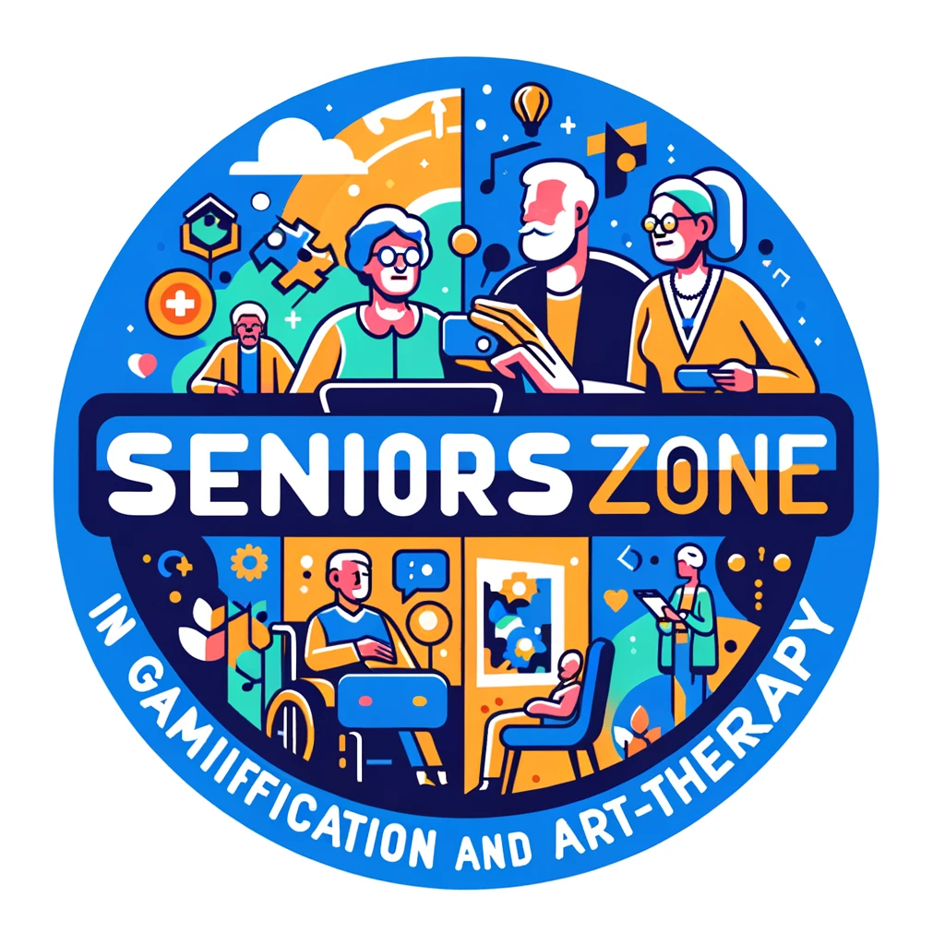
2023-2025 KA210
2023-1-NL01-KA210-ADU-000157474
The "Seniors ZONE in gamification and art-therapy" project consists of a consortium of 3 organizations from EU countries. Our operational objectives are:
1. Develop of extended competencies for workers in the field of adult education by applying the principles of gamification- modern technique and method that facilitates learning at all ages. By applying the principles of gamification and modern methods that facilitate learning at all ages, adult education workers will be able to acquire new skills and knowledge that will help them better fulfill their role in their training activities. 2. Consolidation of the capacity of the 3 organizations to work at transnational level through the implementation of project activities. By implementing the project, the organizations will gain experience in managing transnational projects and will be able to strengthen their international partnerships.
3. Reducing the risk of social exclusion for seniors aged 50+, during the project implementation. The project will have a positive impact on the elderly, contributing to improving their quality of life and preventing the risk of social exclusion.

Slide 12

2023-2026 KA210
Education and Therapy Gardens for Impaired Adult 2023-2-RO01-KA210-ADU-000173575
* To learn plant-growing tools that will improve the physical skills of adults with disabilities.
* To ensure that the impaired are regularly involved in gardening in their education.
*To contribute to the mental development of impaired adults. To enable impaired adults to observe the growth of plants, learn watering times and harvest.
*To create hobby gardens by working as a team in the gardens of our institutions with impaired adults.
*To create an education model with a flexible approach so that the education of impaired adults can be carried out outside the classroom environment.
* To encourage the participation of people with disabilities in classes, to provide support and to create appropriate resources that will increase their motivation in the education process.

Slide 13

2022-2024 KA1
The "Zero Effects of Environment Changes (ZEN)" Project 2022-2-RO01-KA122-ADU-000094582:
This project is aimed at trainers in adult education and adults, including those with disabilities. Its goal is to enhance skills in preventing the effects of climate changes using innovative teaching methodologies and promoting circular economy principles. Tangible outcomes include improved skills in circular economy and environmental protection, while intangible results involve increased motivation and awareness among participants regarding sustainable practices. Project activities include participating in courses such as "Sustainability - Teaching Eco Skills" and "Innovative Approaches in Environmental Education," alongside job shadowing opportunities. This will lead to the improvement of organizational activity plans and awareness of the effects of climate change.

Slide 14
DOCUMENT REALIZAT DE :

